Slide 1
Flow Chart and Phases of Making an Executable Code

Slide 2
Drawing Flowcharts
Flowchart is the graphic representations of the individual steps or actions to implement a particular module
Flowchart can be likened to the blueprint of a building
An architect draws a blueprint before beginning construction on a building, so the programmer draws a flowchart before writing a program
Flowchart is independent of any programming language.

Slide 3
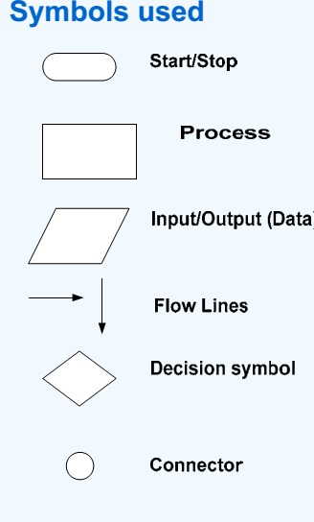
Flow Charts
A flow chart is an organized combination of shapes, lines and text that graphically illustrate a process or structure.
Notes:
Flow Charts are used to help programmers during the early stages of programming. Flow Charts allow the programmer to set out, in a very simple way the sequence that he/she wants for each line of the program. A flow chart is an organized combination of shapes, lines and text that graphically illustrates a process or structure. Here's an example of how you could use shapes, lines, and text to build a chart: • The shapes (such as rectangles, circles, or diamonds) represent each step or decision point in the process. • The lines show the continuity of the process, demonstrating the paths the user should follow. • The text briefly describes each part of the process. A flow chart can be used for: (1) defining and analyzing processes (2) building a step-by-step picture of the process for analysis, discussion, or communication purposes (3) defining, standardizing, or finding areas for improvement in a process

Slide 4
PRE-PROGRAMMING PHASE
Symbol | Function
 | Show the direction of data flow or logical solution.
 | Indicate the beginning and ending of a set of actions or instructions (logical flow) of a module or program.
 | Indicate a process, such as calculations, opening and closing files.

Slide 5
PRE-PROGRAMMING PHASE
 | Indicate input to the program and output from the program.
 | Use for making decision. Either True or False based on certain condition.
 | Use for doing a repetition or looping of certain steps.
 | Connection of flowchart on the same page.
 | Connection of flowchart from page to page.

Slide 6
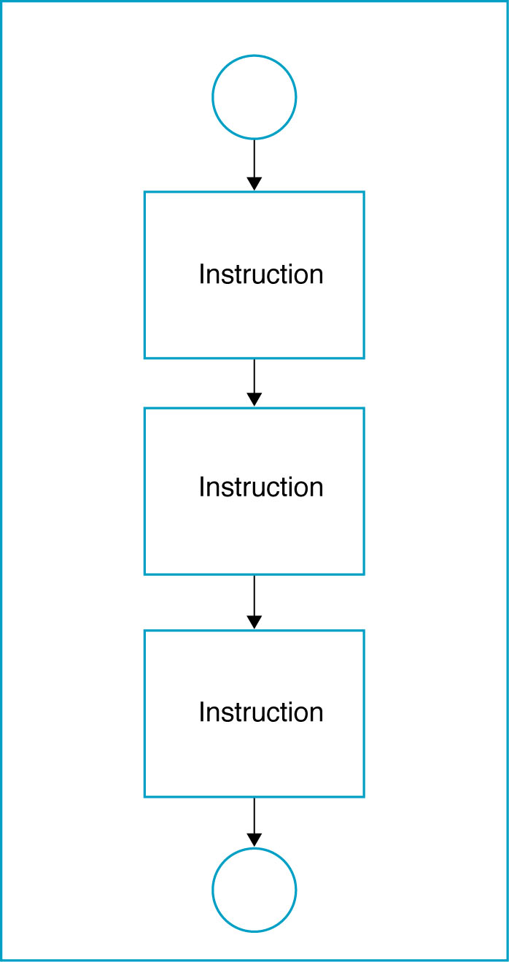
Sequential Logic Structure

Slide 7
Sale Problem
Given the unit price of a product and the quantity of the product sold, draw a flowchart to calculate and print the total sale.
Solution: Stepwise Analysis of the Sale Problem
Read the unit price and the quantity
Calculate total sale = unit price and quantity
Print total sale

Slide 8
PRE-PROGRAMMING PHASE
START
A
READ
UNIT PRICE
TOTAL SALE =
UNITPRICE × QUANTITY
READ
QUANTITY
PRINT
TOTALSALE
A
STOP

Slide 9
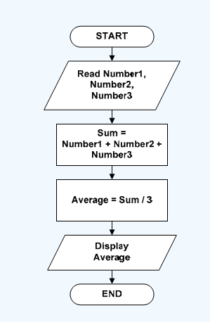
Find the average of three numbers

Slide 10
The Decision Logic Structure
Implements using the IF/THEN/ELSE instruction.
Tells the computer that IF a condition is true, THEN execute a set of instructions, or ELSE execute another set of instructions
ELSE part is optional, as there is not always a set of instructions if the conditions are false.
Algorithm:
IF <condition(s)> THEN
<TRUE instruction(s)>
ELSE
<FALSE instruction(s)

Slide 11
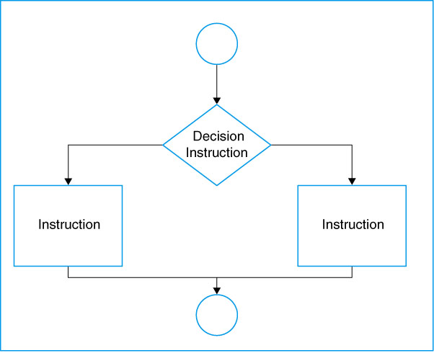
Decision Logic Structure

Slide 12
Examples of conditional expressions
A < B (A and B are the same data type – either numeric, character, or string)
X + 5 >= Z (X and Z are numeric data)
E < 5 or F > 10 (E and F are numeric data)
DATAOK (DATAOK – logical datum)

Slide 13
Conditional Pay Calculation
Assume your are calculating pay at an hourly rate, and overtime pay(over 40 hours) at 1.5 times the hourly rate.
IF the hours are greater than 40, THEN the pay is calculated for overtime, or ELSE the pay is calculated in the usual way.

Slide 14
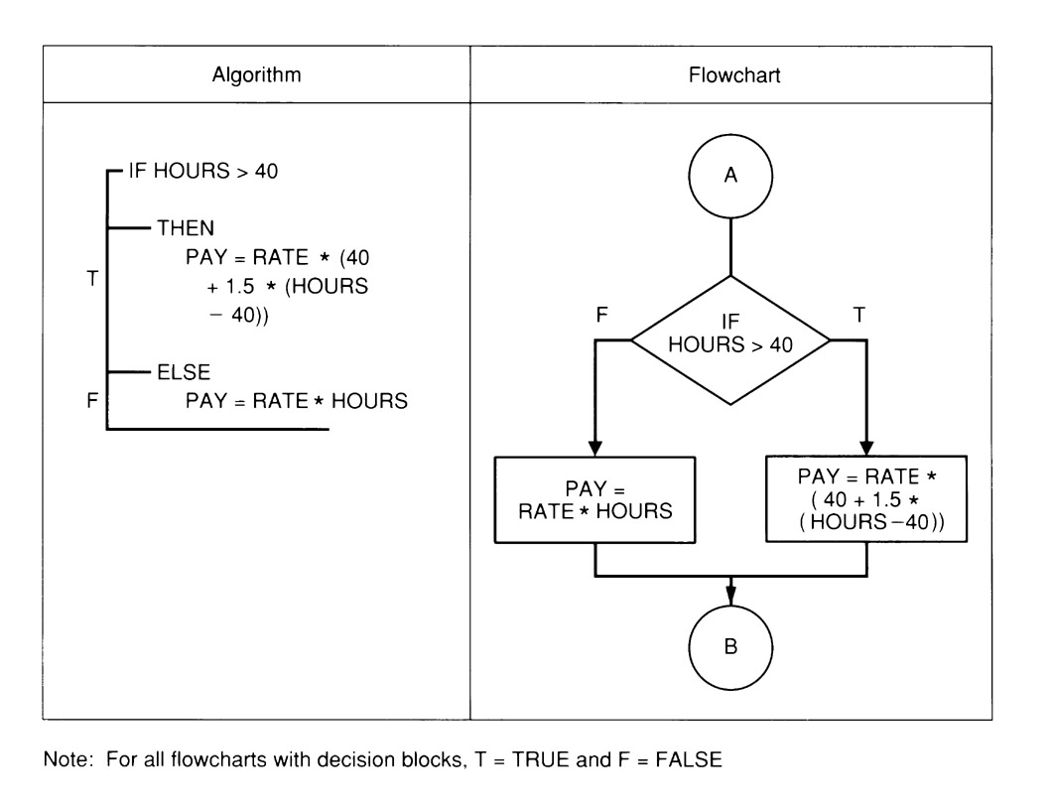
Example Decision Structure

Slide 15
NESTED IF/THEN/ELSE INSTRUCTIONS
Multiple decisions.
Instructions are sets of instruction in which each level of a decision is embedded in a level before it.

Slide 16
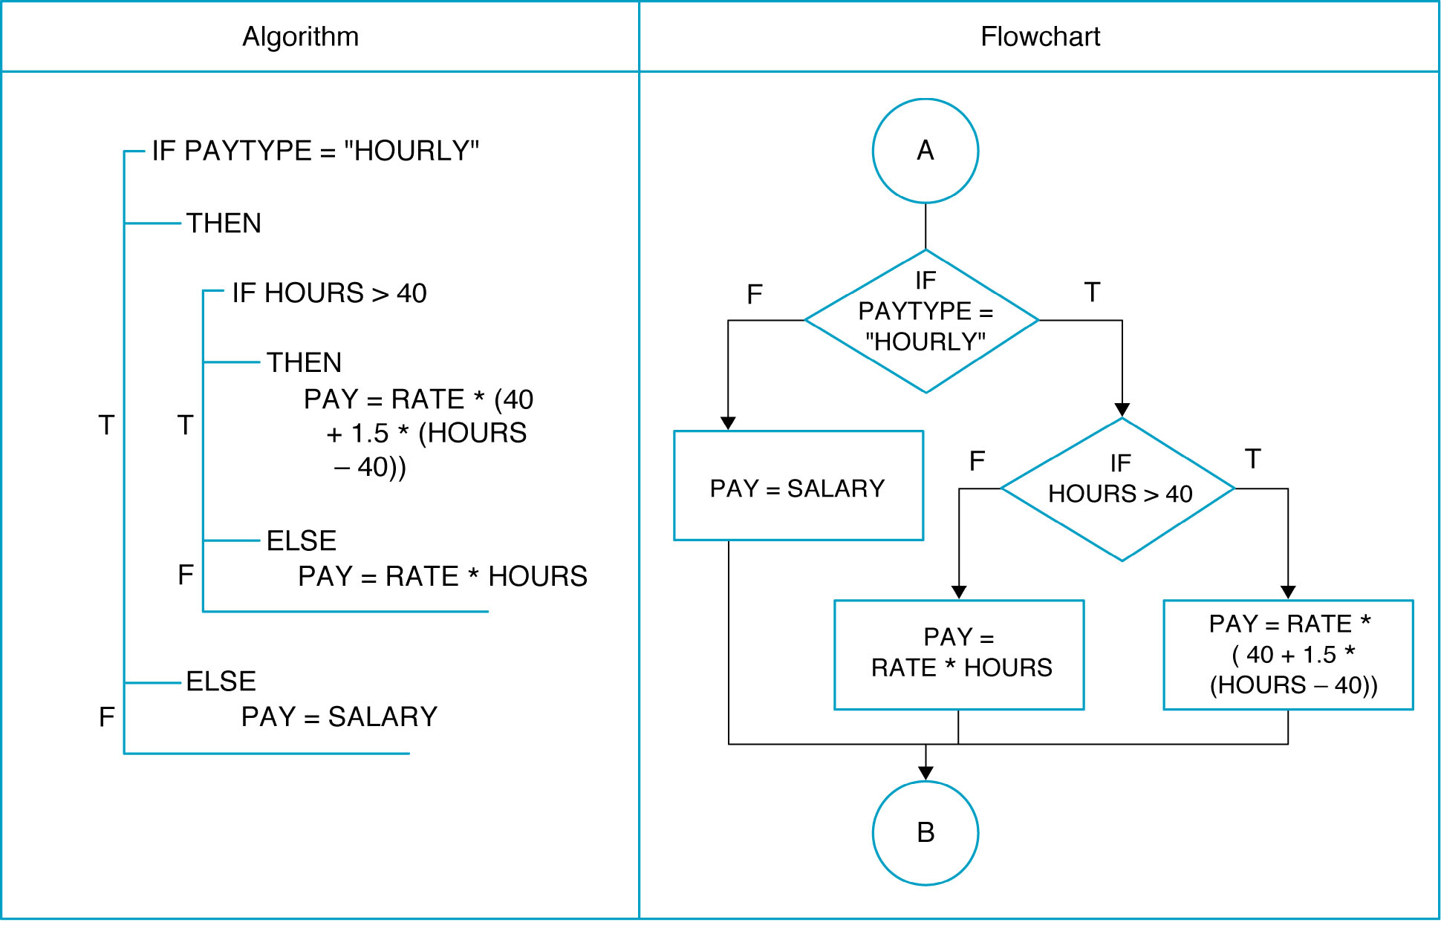
NESTED IF/THEN/ELSE INSTRUCTIONS

Slide 17
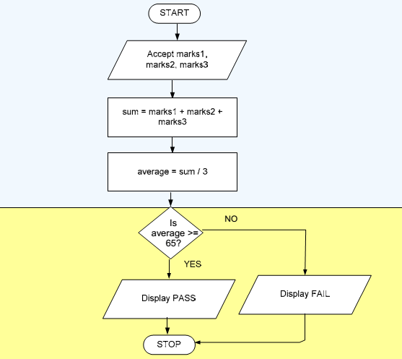
Flow Chart - Selectional

Slide 18
Iterational Structure
Repeat structure
To solve the problem that doing the same task over and over for different sets of data
Types of loop:
WHILE loop
Do..WHILE loop
Automatic-Counter Loop

Slide 19
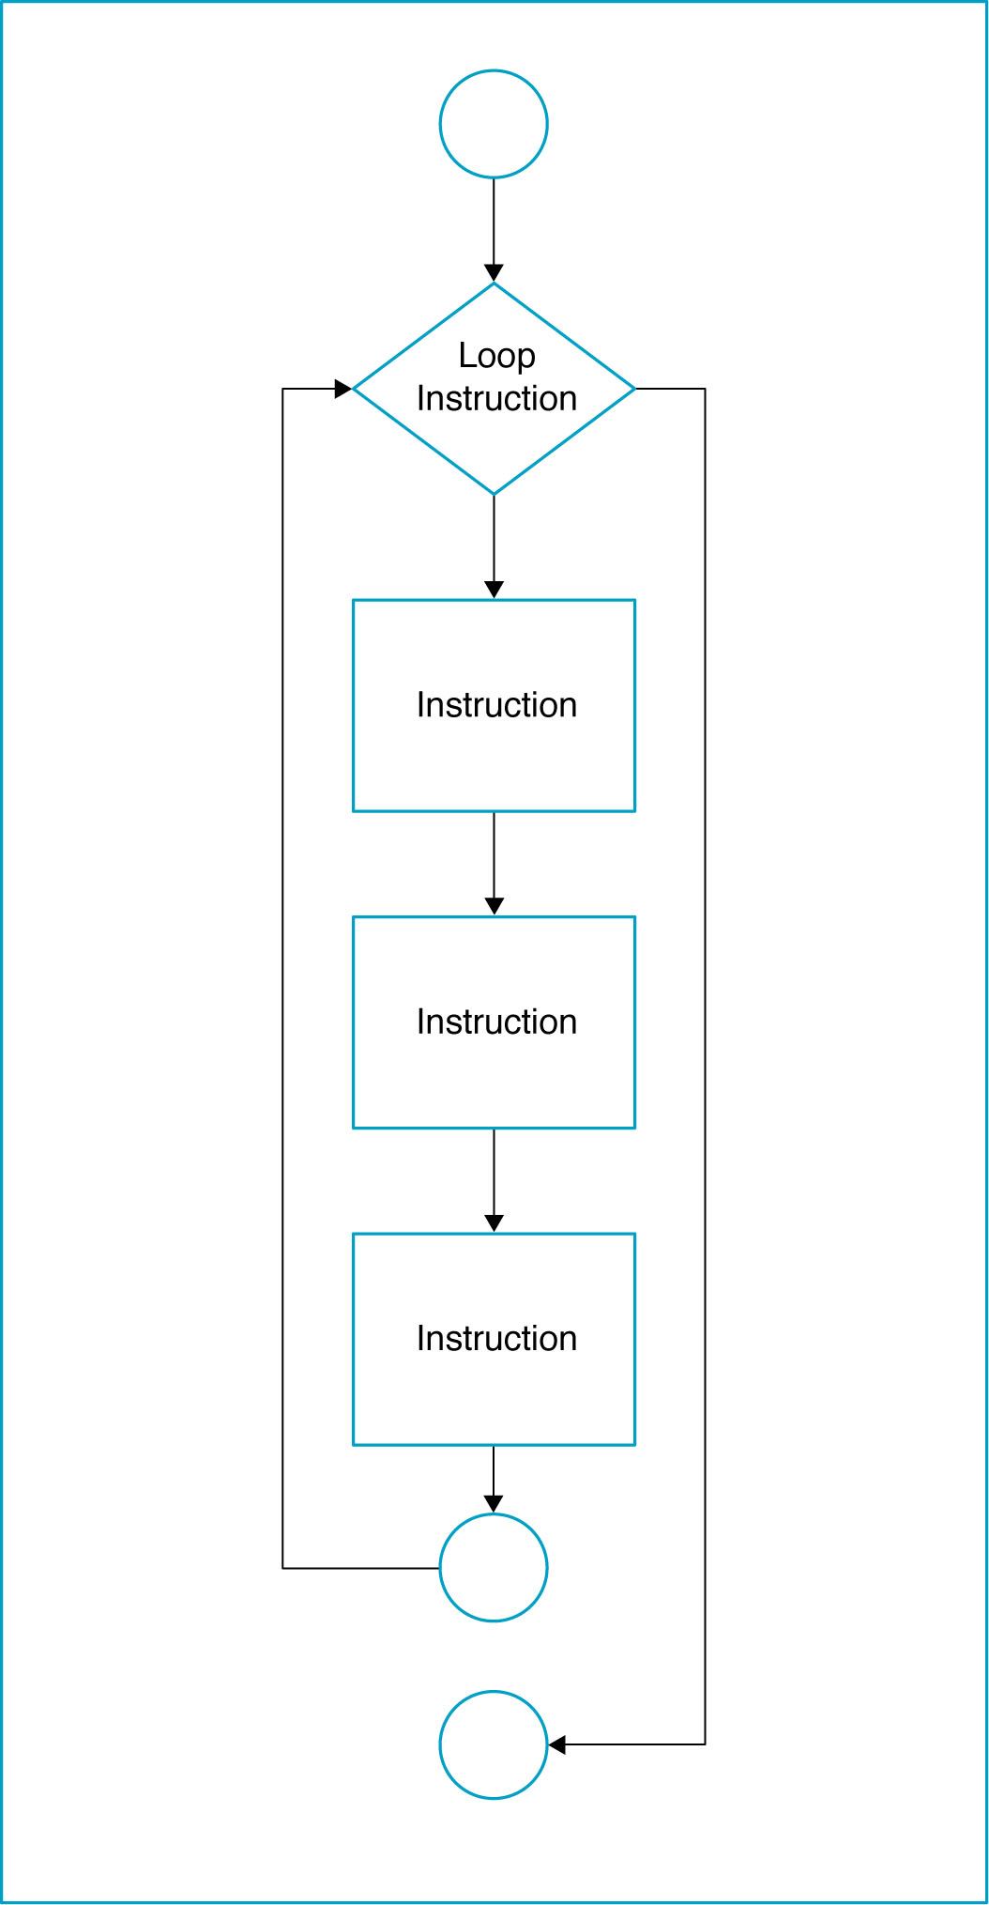
Loop Logic Structure

Slide 20
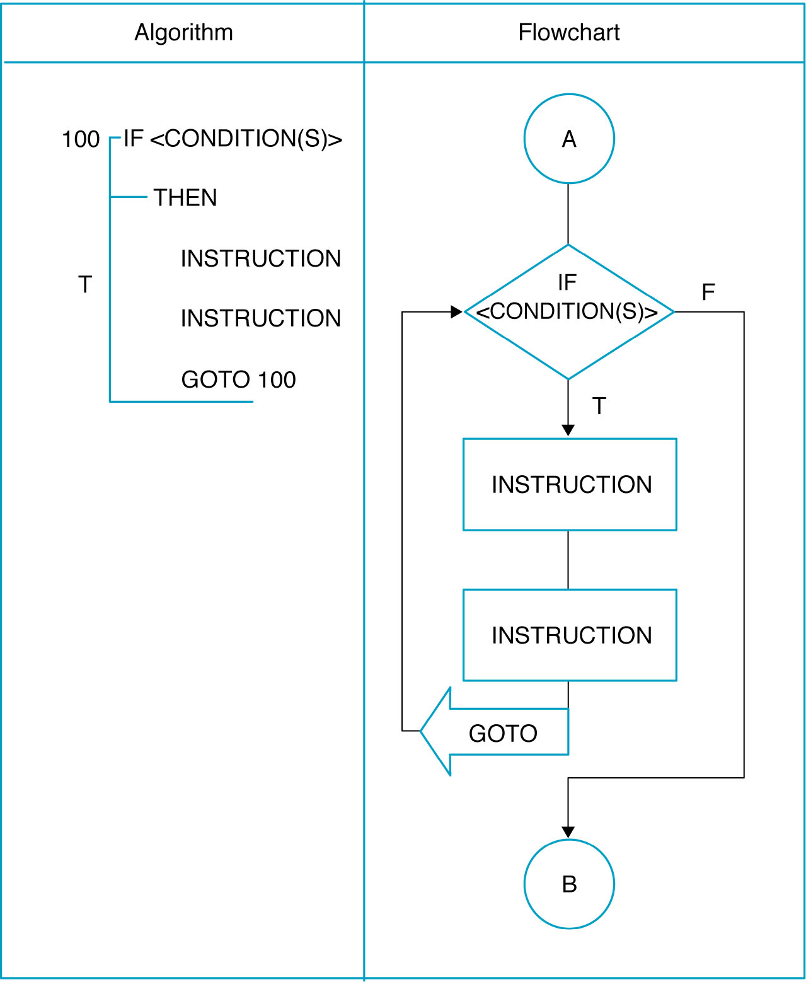
WHILE loop

Slide 21
WHILE loop
Do the loop body if the condition is true.
Example: Get the sum of 1, 2, 3, …, 100.
Algorithm:
Set the number = 1
Set the total = 0
While (number <= 100)
total = total + number
number = number + 1
End While
Display total

Slide 22
WHILE loop
Start
Set number = 1
Set total = 0
number <= 100
No
Yes
Display total
total =
total + number
End
number =
number + 1

Slide 23
Automatic Counter Loop
Use variable as a counter that starts counting at a specified number and increments the variable each time the loop is processed.
The beginning value, the ending value and the increment value may be constant.
They should not be changed during the processing of the instruction in the loop.

Slide 24
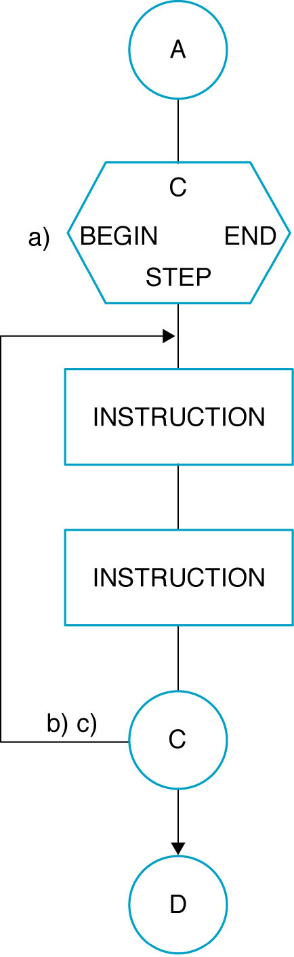
Automatic-Counter Loop

Slide 25
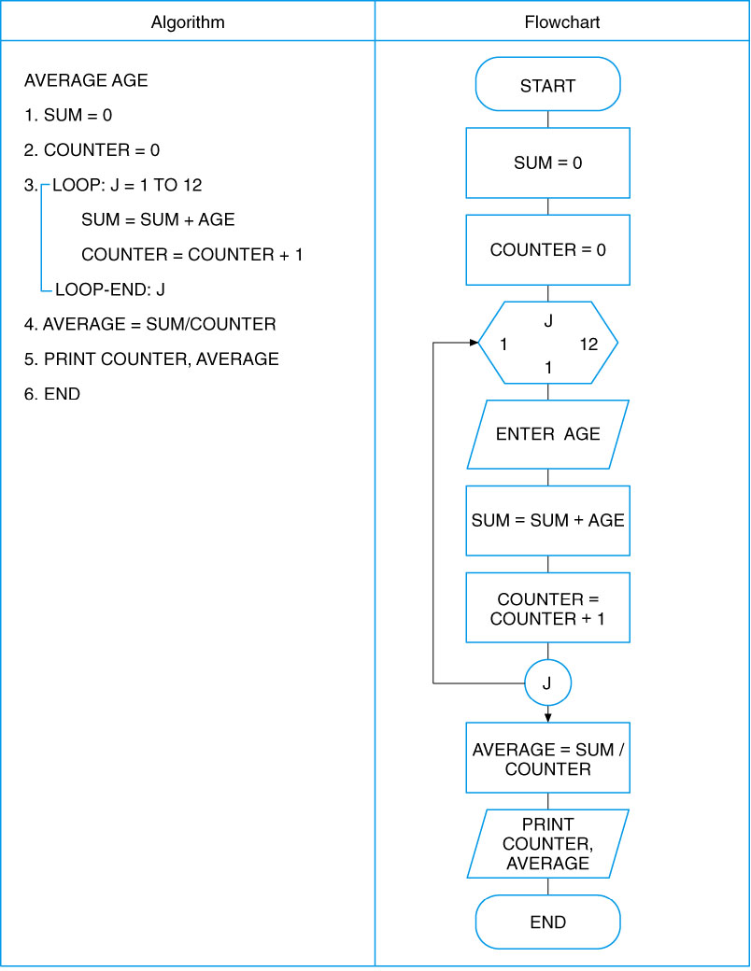
Automatic-Counter Loop

Slide 26
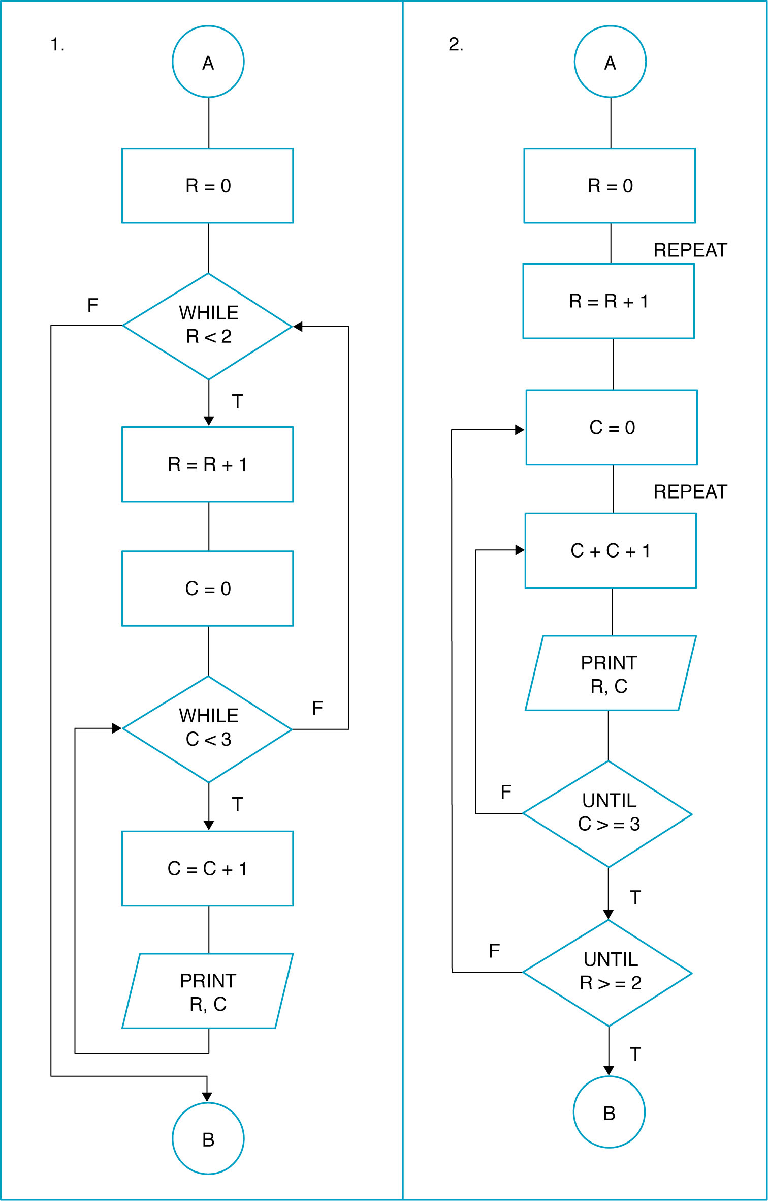
NESTED LOOP

Slide 27
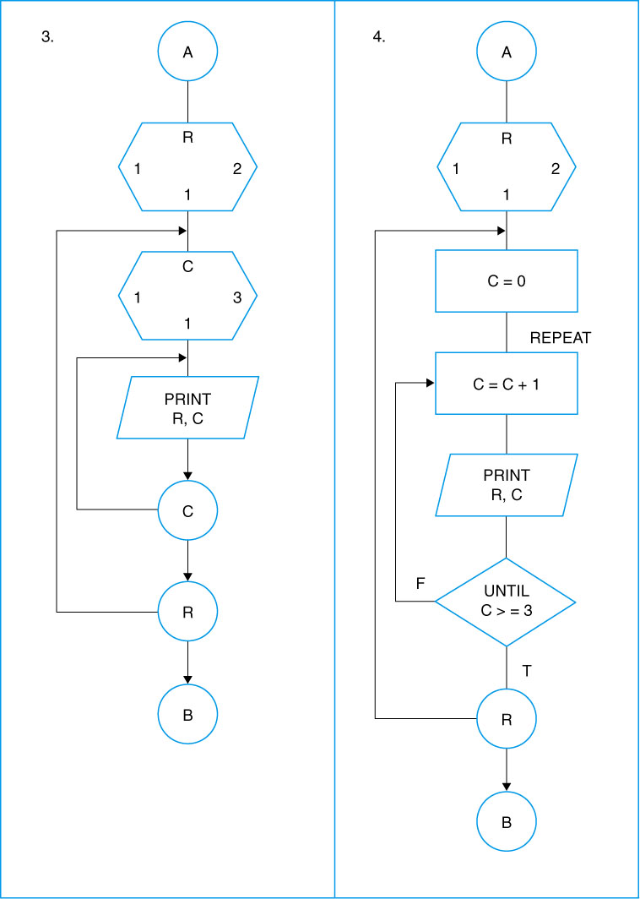
NESTED LOOP

Slide 28
Example (Iterational)
Write a program to find the average of marks scored by him in three subjects for ‘N’ students. And then test whether he passed or failed. For a student to pass, average should not be less than 65.
Notes:
Now lets extend the scope of our algorithms. The problem definition now needs to give us solution for a set of input values. This introduces to us the the concepts of looping constructs. Loops are used when we want to execute a part of a program or a block of code to be executed several times. Iterational constructs in general could be of two types: (1) Fixed – here the number of times the block of code to be executed is known before hand. (2) Variable – here the number of times the block of code to be executed is not known. Depending upon the user’s choice, the block could be executed many times.

Slide 29
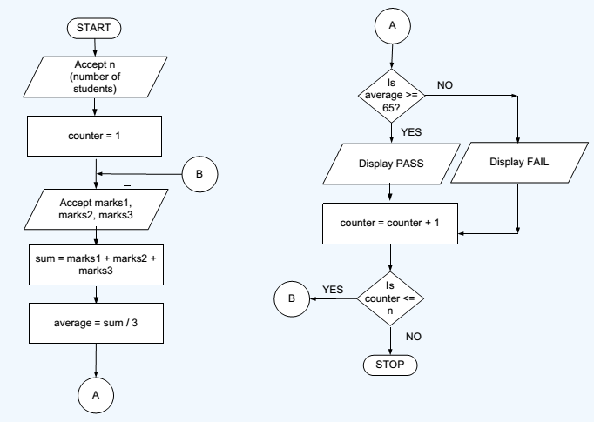
Flow Chart Iterational

Slide 30
Tool demo
Yed tool shall be used for giving demo

Slide 31
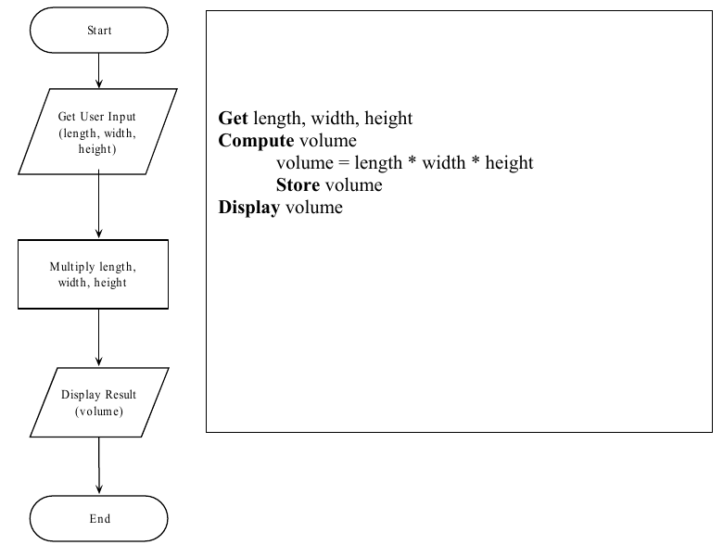
Pseudocode – Partial English and Programming Language terms

Slide 32
Programming Or Implementation Phase
Transcribing the logical flow of solution steps in flowchart or algorithm to program code and run the program code on a computer using a programming language.
Programming phase takes 5 stages:
Coding.
Compiling.
Debugging.
Run or Testing.
Documentation and maintenance.

Slide 33
Programming Or Implementation Phase
Once the program is coded using one of the programming language, it will be compiled to ensure there is no syntax error.
Syntax free program will then be executed to produce output and subsequently maintained and documented for later reference.

Slide 34
CODING
COMPILE THE
PROGRAM
MAKE
CORRECTION
NO SYNTAX
ERROR
EXECUTE OR
RUN
DOCUMENTATION OR MAINTENANCE

Slide 35
Coding
Translation or conversion of each operation in the flowchart or algorithm (pseudocode) into a computer-understandable language.
Coding should follow the format of the chosen programming language.

Slide 36
Compiling and Debugging
Compiling - Translates a program written in a particular high–level programming language into a form that the computer can understand
Compiler checks the program code so that any part of source code that does not follow the format or any other language requirements will be flagged as syntax error.
This syntax error in also called bug, when error is found the programmer will debug or correct the error and then recompile the source code again
Debugging process is continued until there is no more error in program

Slide 37
Testing
The program code that contains no more error is called executable program. It is ready to be tested.
When it is tested, the data is given and the result is verified so that it should produced output as intended.
Though the program is error free, sometimes it does not produced the right result. In this case the program faces logic error.
Incorrect sequence of instruction is an example that causes logic error.

Slide 38
Documentation and Maintenance
When the program is thoroughly tested for a substantial period of time and it is consistently producing the right output, it can be documented.
Documentation is important for future reference. Other programmer may take over the operation of the program and the best way to understand a program is by studying the documentation.
Trying to understand the logic of the program by looking at the source code is not a good approach.
Studying the documentation is necessary when the program is subjected to enhancement or modification.
Documentation is also necessary for management use as well as audit purposes.

Slide 39
Best Practices
Develop efficient computer solution to problems:
Use Modules
Use four logic structures
Sequential structure
Executes instructions one after another in a sequence.
Decision structure
Branches to execute one of two possible sets of instructions.
Loop structure
Executes set of instruction many times.
Case structure
Executes one set of instructions out of several sets.
Eliminate rewriting of identical process by using modules.
Use techniques to improve readability including four logic structure, proper naming of variables, internal documentation and proper indentation.

